Slide 1
Big Mountain Resort
Pricing Strategy
Surya Iyer

Slide 2
Problem Statement
New Chair lift leads to increasing Operating Costs
Increase Ticket Prices
Cost Cutting

Slide 3
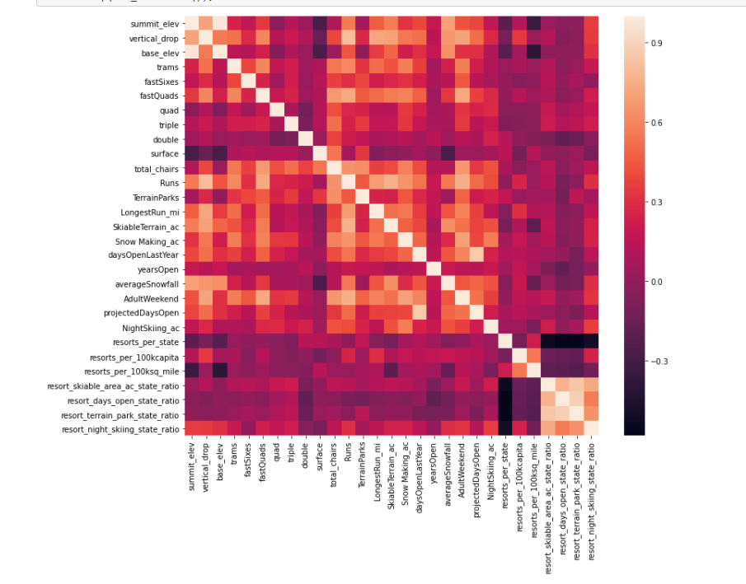
Important Features
fastQuads
Resort Night Skiing State Ratio
Runs
Total chairs
Vertical drop

Slide 4
Linear Model
Vertical drop is your biggest positive feature.
Area covered by snow making equipment is a strong positive as well.
The skiable terrain area is negatively associated with ticket price
Total Chairs, Fast Quads and Number of Run have positive relation
Feature | Coefficient
Vertical Drop | 10.767857
Snow Making | 6.290074
Total Chairs | 5.794156
Fast Quads | 5.745626
Runs | 5.370555
LongestRun_mi | 0.181814
Number of Trams | -4.142024
Skiable Area | -5.24978

Slide 5
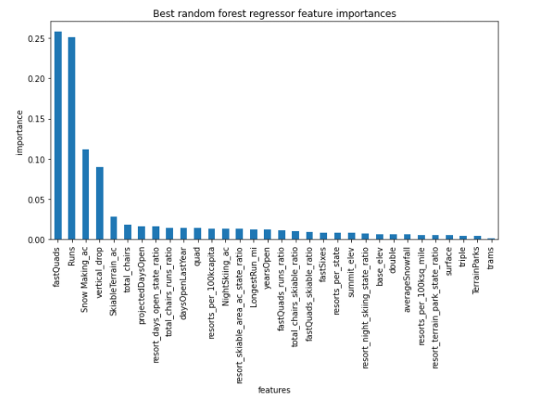
Random Forest Model
Fast Quads
Runs
Snow Making_ac
vertical_drop

Slide 6
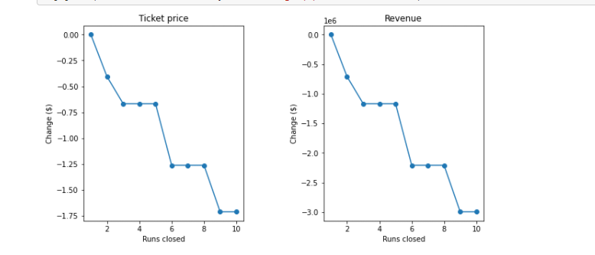
Model Results
Current price is $81 but Suggested price is $94
Reducing a run does not affect Revenue
Adding Chair lift would lead to $507,246 increase in revenue but $1,540,000 operating Costs

Slide 7
Actionables
Increase Price to $94
Don‘t add a chair lift since operating costs will be more than Revenue
Close one of the runs

